Slide 1
TDL Project – To-Do-List Application
Waleed Tahir
20DecSoftware1

Slide 2
Introduction
Name Waleed Tahir
QA trainee
The overall objective of the project was:
To create an OOP-based web application, with utilisation of supporting tools, methodologies, and technologies, that encapsulates all fundamental and practical modules covered during training.

Slide 3
Concept
To Breakdown the project I looked at the MVP deliverable features which and broke them down into individual user stories and tasks for my Kanban Board and then went about completing the required tasks before looking at any further function that could be added to my application.

Slide 4
Sprint Plan
Back-end application with full CRUD functionality
Unit and Integration Testing
Git repository and management
Full supporting documentation including UML and ERD diagrams
Build Tool Maven
Project Management platform – Jira-Kanban Board
Fully integrated front end

Slide 5
Consultant Journey
Version control –Git(Git Hub and Git Bash)
Programming language – java, javascript, html and css
Database – local:H2
Testing- JUnit, Integration and Selenium
Static analysis – Sonarqube
Project management – Jira

Slide 6
Continues Integration
The Version Control System that I used was Git;
Use a mix of GitBash console and Github to manage iterations of my project working within the Master->Dev->features model to ensure full clarity and safety of my code.
Regular commits to ensure Code is update operating using swift design principles by ensuring that a copy of my latest working code was always available in my repository.

Slide 7
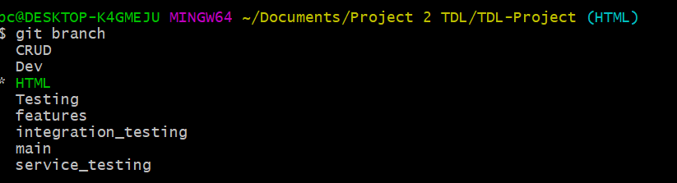
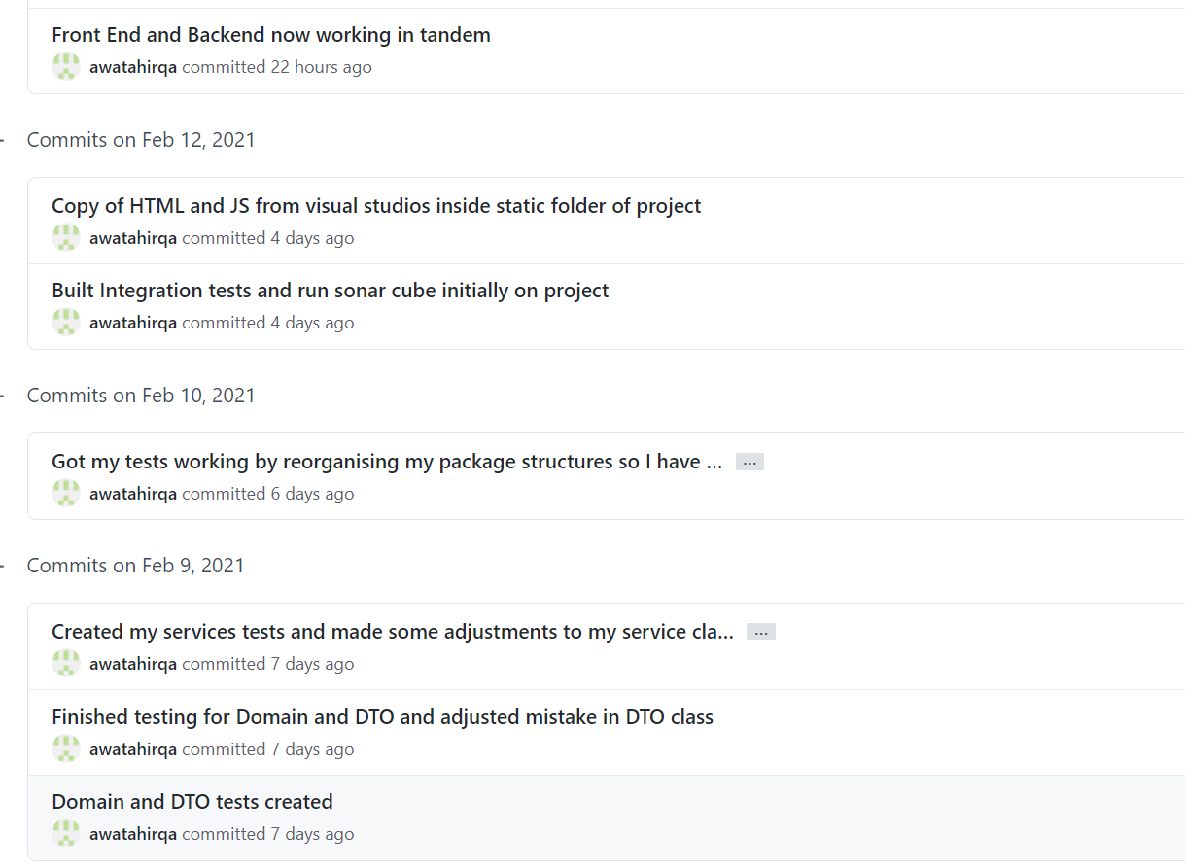
CI
Branch models
Commit history ensuring regular updates

Slide 8
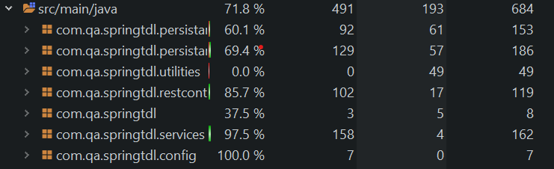
Testing
Testing was completed using a combination of both JUnit Integration and Selenium
JUnit was used to test the individual methods within each of my classes by initialising the relevant objects in my test setup and then calling the method to test it.
Integration testing with JUnit 5 allows us to see if the HTTP endpoints in our application work with various CRUD-based HTTP requests. This makes use of the Controller layer, which can be 'mocked' so that we can test the outcomes of sending data to each HTTP endpoint.
coverage at 71.8%

Slide 9
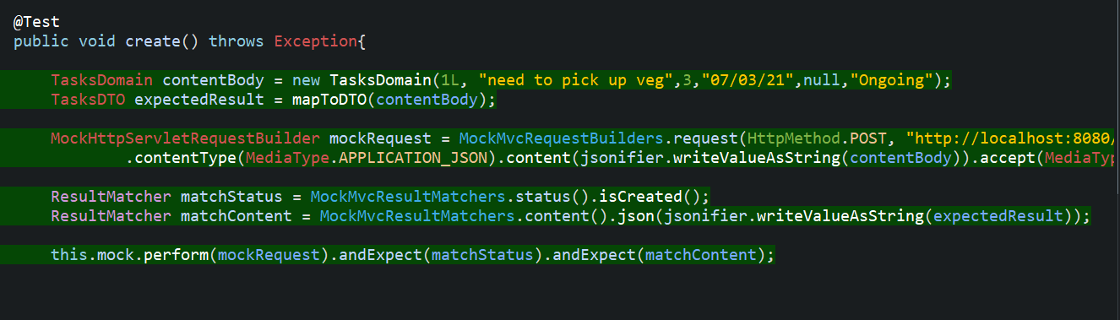
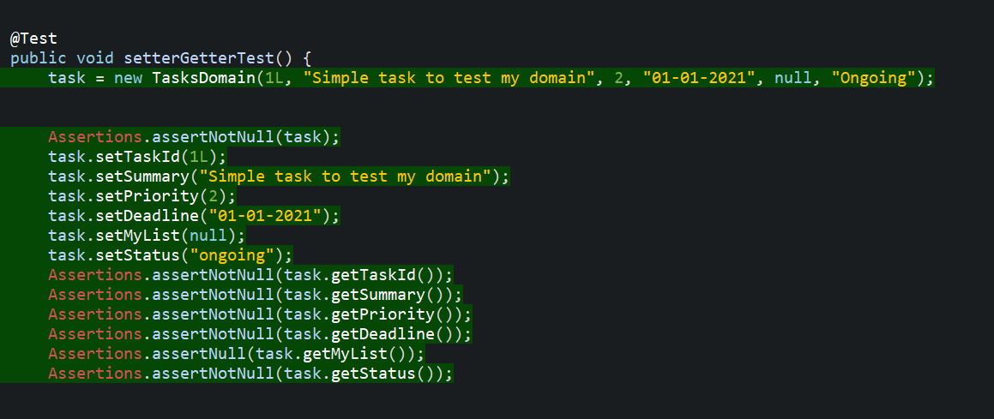
JUnit
Integration

Slide 10
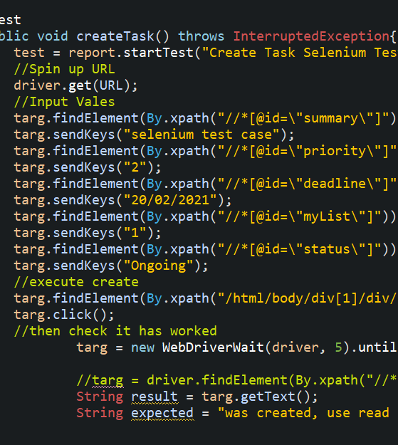
Selenium
Selenium is a collection of tools and libraries used to automate web browsers, and is used for User acceptance testing. It can be broken down into three main components Given, when and then

Slide 11
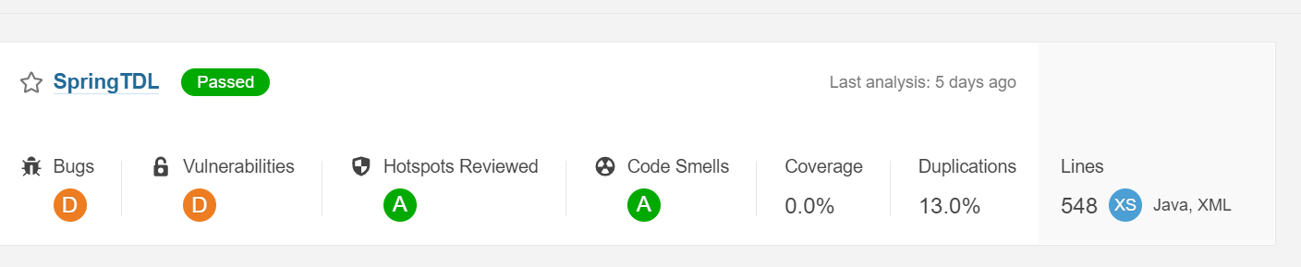
Static analysis - SonarQube
SonarQube is an open-source platform developed by SonarSource for continuous inspection of code quality to perform automatic reviews with static analysis of code to detect bugs, code smells, and security vulnerabilities

Slide 12
Demonstration
User story : As a user I want to be able to create tasks so that I can keep track of my outstanding work and organise them within my ToDoList.
User Story: As a user I want to be able to delete a task so that I can keep my ToDoList clear of any unnecessary information.

Slide 13
Sprint Review
I managed to complete the core functionality of my code;
CRUD services for Back end
Fully operation Front end
Junit and Integration Tests
What got left behind;
Testing coverage not able to reach 80%
Additional functionality such as Users access control.
Optimized my code by reducing smells identified by sonarqube.

Slide 14
Sprint Retrospective
What went well?
Back end functionality
Front End Integration
Unit and Integration Testing
Improvements
Adding further functionality to the code
More efficient/cleaner code e.g. Lombock
Higher test coverage
Cleaner Selenium Tests using POM design model

Slide 15
Conclusion
Core Aim of the Brief met
I have deepened my understanding of the technologies learnt over the course of the project
Moving forward continue to improve and as I gain experience complete my project with more functionality.
Complete Optimization and improve code making use of technologies such as sonarqube to improve weaknesses in my code
Thank you for Listning are there any Question?

